Slide 1
RxJS
Combining All the Streams
Lecture 11
By James(Jin) Wang
12/05/2021

Slide 2
Outline
Handling related data
Creating ancillary streams
Combining all the streams

Slide 3
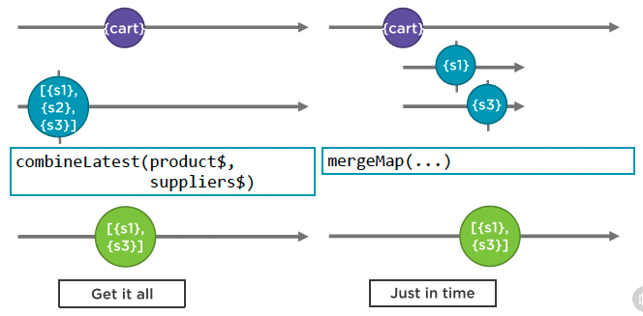
Handling related data
  Related Data Streams

Slide 4
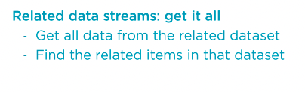
Handling related data
  Related data streams: get it all
  Demo: get it all

Slide 5
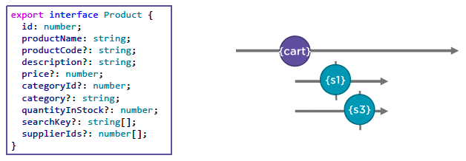
Handling related data
  Related data streams: Just in Time

Slide 6
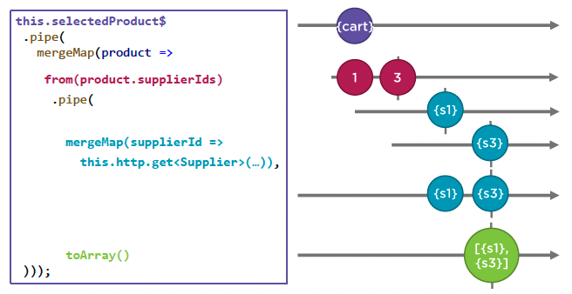
Handling related data
  Related data streams: Just in Time
  Demo: just in time

Slide 7
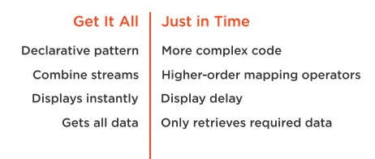
Handling related data
  Related data streams

Slide 8
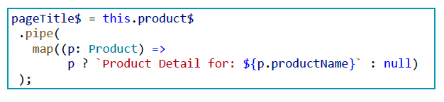
Ancillary Streams
  Defining ancillary streams
  Demo: ancillary streams

Slide 9
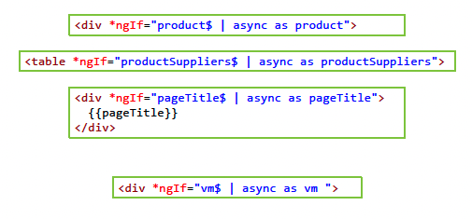
Combine all Streams
  Multiple Async Pipes
  Demo: combine all streams

Slide 10
Summary

Slide 11
Assignment

Slide 12
Self Study
  RxJS: The Big Picture
  https://app.pluralsight.com/library/courses/rxjs-big-picture

